Slide 2
EV Market Outlook

Slide 3
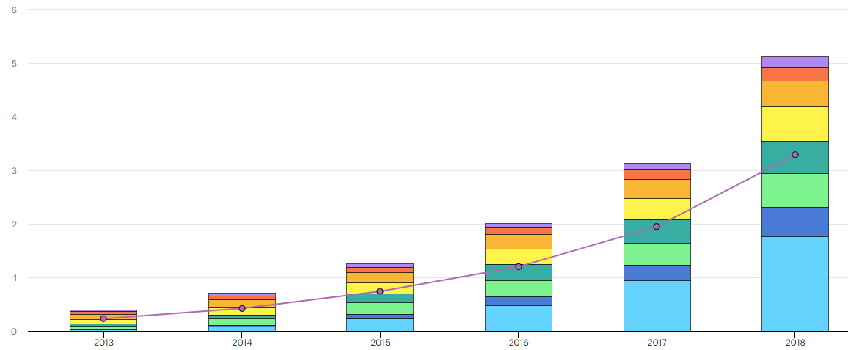
Global stock of electric passenger cars passing 5 million in 2018, an increase of 63% from the previous year.
Around 45% of electric cars on the road in 2018 were in China – a total of 2.3 million – compared to 39% in 2017. In comparison, Europe accounted for 24% of the global fleet, and the United States 22%.

Slide 4
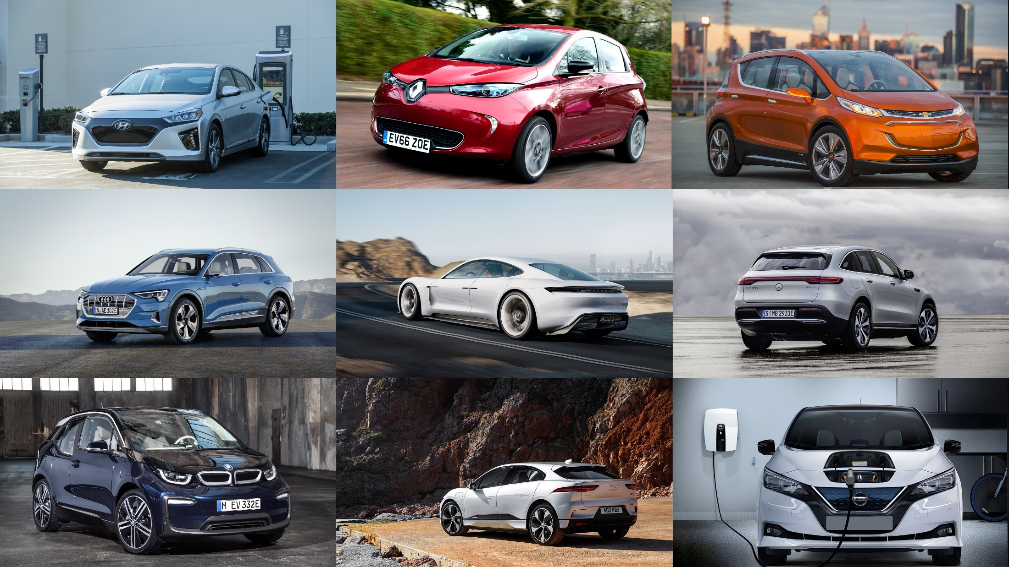
McKinsey & Company predicts 350 EV models will debut by 2025,
and 120 million electric vehicles will be on the road by 2030.

Slide 5
Zero-Emission in California
California has a goal of 5 million ZEVs on the roads by 2030 and 250,000 electric vehicle charging stations by 2025.
Source: California Public Utilities Commission

Slide 6
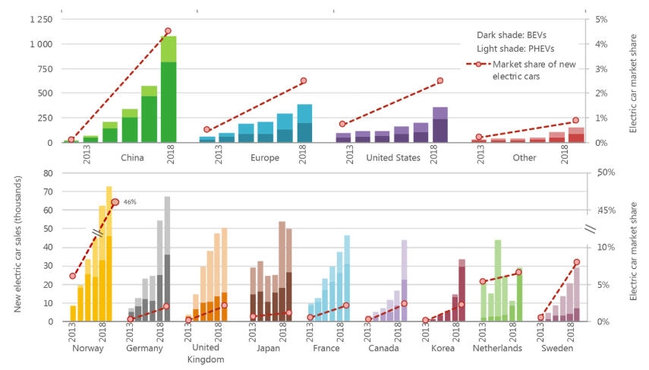
Global electric car sales and market share, 2013-2018

Slide 7
Policies have major influences on the development of electric mobility
 |  | Canada | China | European Union | India | Japan | United States
Regulations (vehicles) | ZEV mandate | ✓* | ✓ |  |  |  | ✓*
 | Fuel economy standards | ✓ | ✓ | ✓ | ✓ | ✓ | ✓
Incentives (vehicles) | Fiscal incentives | ✓ | ✓ | ✓ | ✓ |  | ✓
Targets (vehicles) |  | ✓ | ✓ | ✓ | ✓ | ✓ | ✓*
Industrial policies | Subsidy | ✓ | ✓ |  |  | ✓
Regulations (chargers) | Hardware standards | ✓ | ✓ | ✓ | ✓ | ✓ | ✓
 | Building regulations | ✓* | ✓* | ✓ | ✓ |  | ✓*
Incentives (chargers) | Fiscal incentives | ✓ | ✓ | ✓ |  | ✓ | ✓*
Targets (chargers) |  | ✓ | ✓ | ✓ | ✓ | ✓ | ✓*

Slide 8
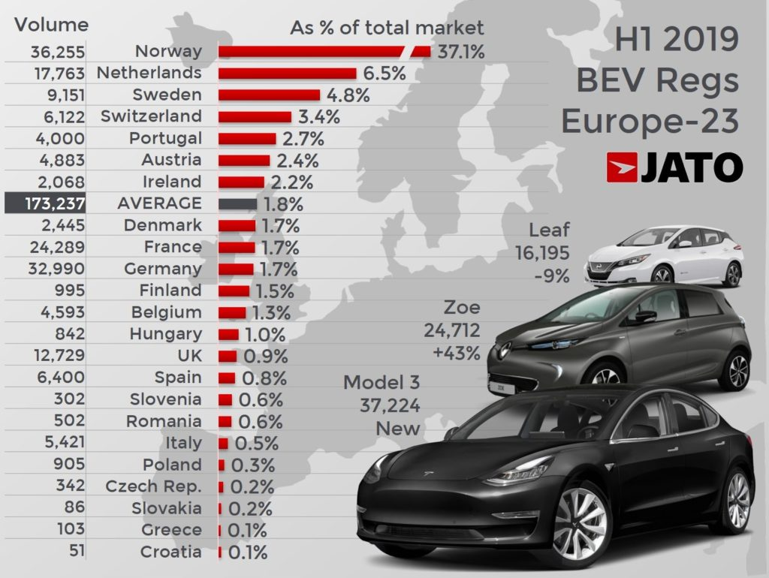
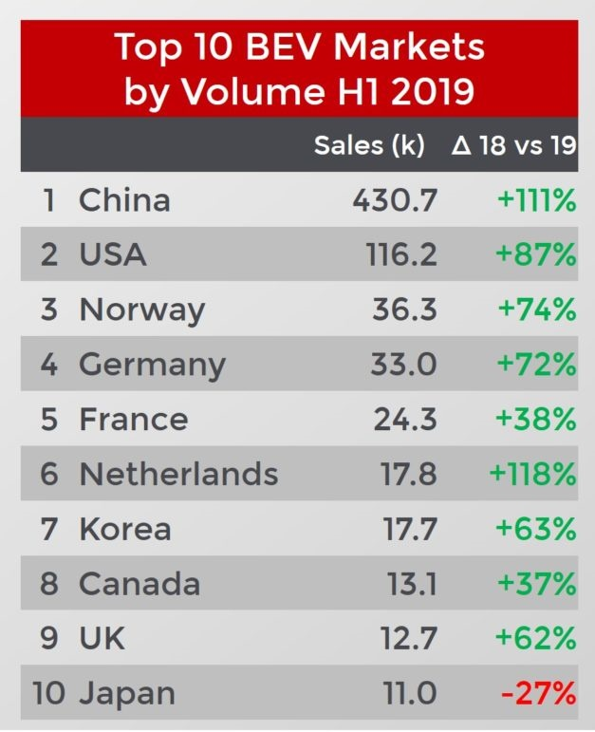
Global EV Sales in H1 2019

Slide 9
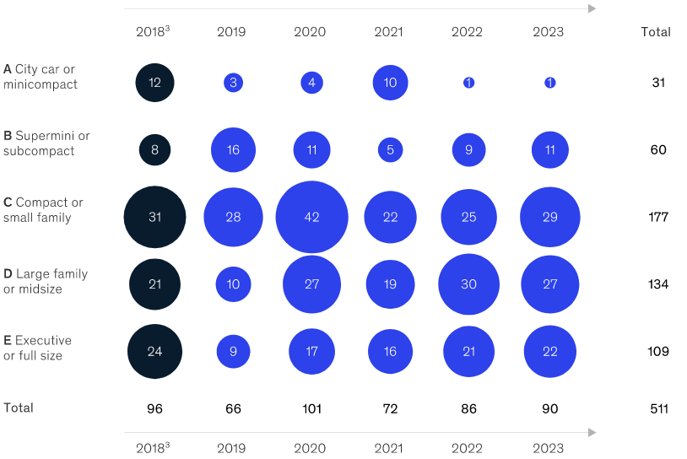
Established OEMs will launch around 400 new EV models through 2023
The international OEMs are expected to launch 66 EV models in 2019 and 101 models in 2020, including several models in larger D and E segments—as well as SUVs and crossovers. These launches are part of a bigger strategy, as automakers need to comply with increasingly stringent CO₂-emission regulations in Europe as well as Corporate Average Fuel Consumption (CAFC), New-Energy Vehicle (NEV), and other regulations in China.

Slide 10
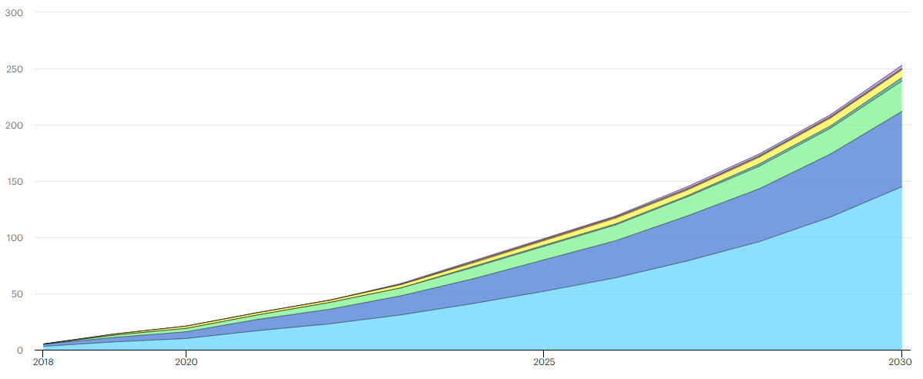
Outlook for growth
The EV30@30 campaign, launched at the Eighth Clean Energy Ministerial in 2017, set the collective aspirational goal for all EVI members of a 30% market share for electric vehicles in the total of all vehicles (except two-wheelers) by 2030. Under the EV30@30 Scenario, EV sales reach 44 million vehicles per year by 2030. In the EV30@30 Scenario, EV sales and stock nearly double by 2030: sales reach 44 million and the stock is larger than 250 million

Slide 11
Noodoe EV Hospitality Solution

Slide 12
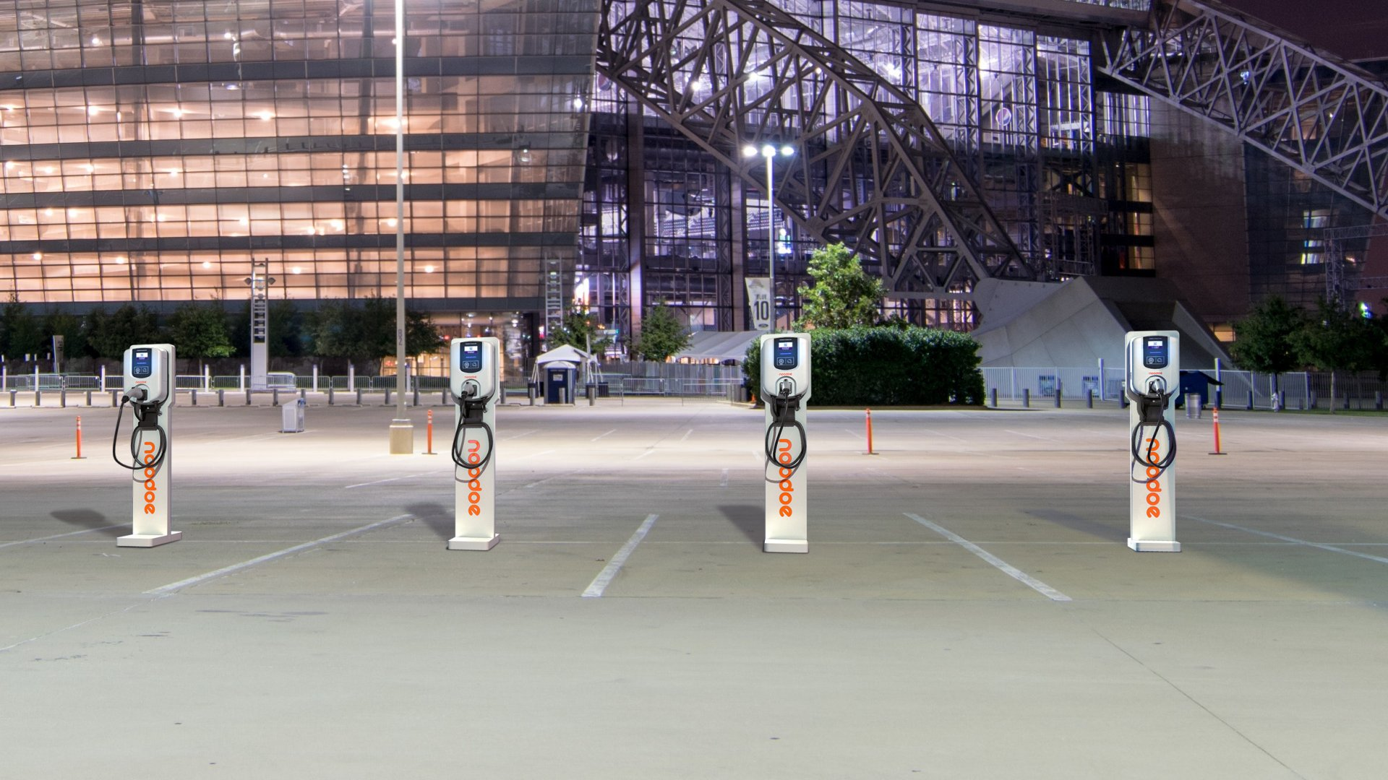
Noodoe enables shopping plazas, malls, and businesses to
turn their parking lots into profitable revenue generators.

Slide 13
Noodoe enables hotels to turn their parking lots into profitable revenue generators and provide guest satisfaction. EV Guests are now choosing their hotels based on whether they have EV Charging.

Slide 14
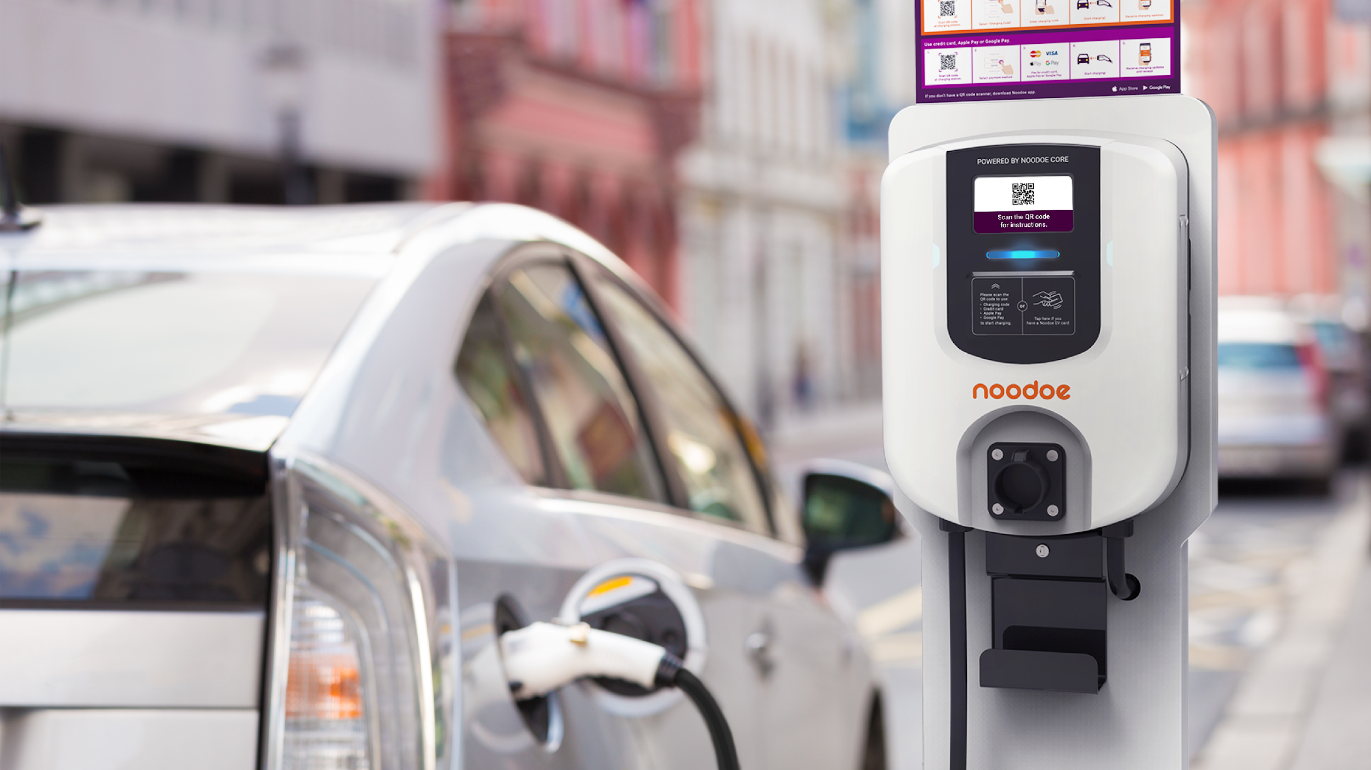
Noodoe provides charging infrastructure for governments
and energy companies to build eco-friendly smart cities.

Slide 15
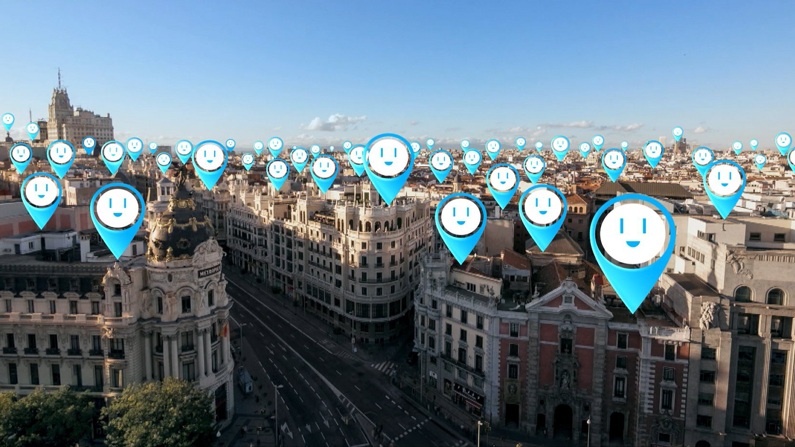
Because of Noodoe EV OS, developing an EV Infrastructure is smooth sailing

Slide 16
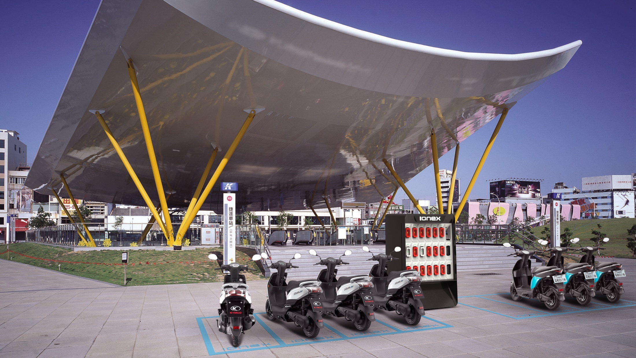
Beyond automobiles, Noodoe EV charging infrastructure solutions
also transform the motorcycle industry in Europe and Asia.

Slide 17
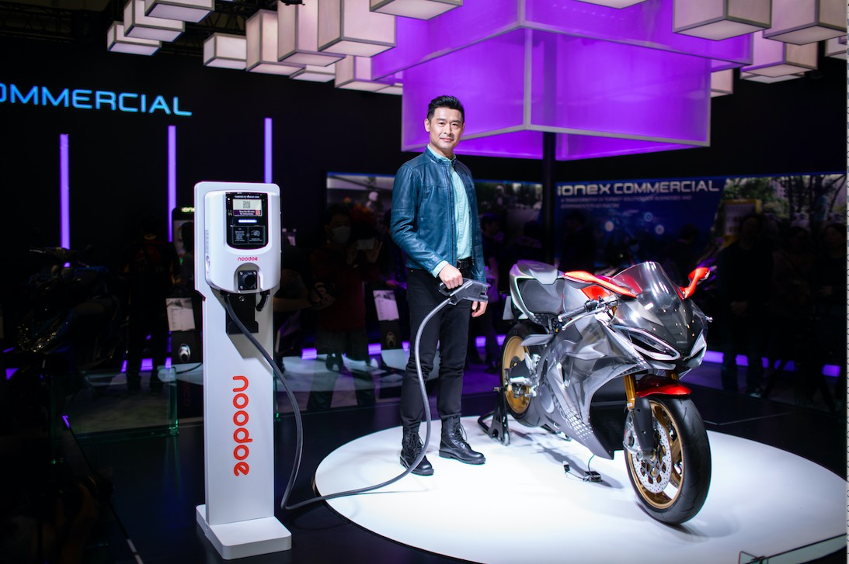
March 22nd, 2019
Tokyo, Japan
Global Motorcycle Show

Slide 18
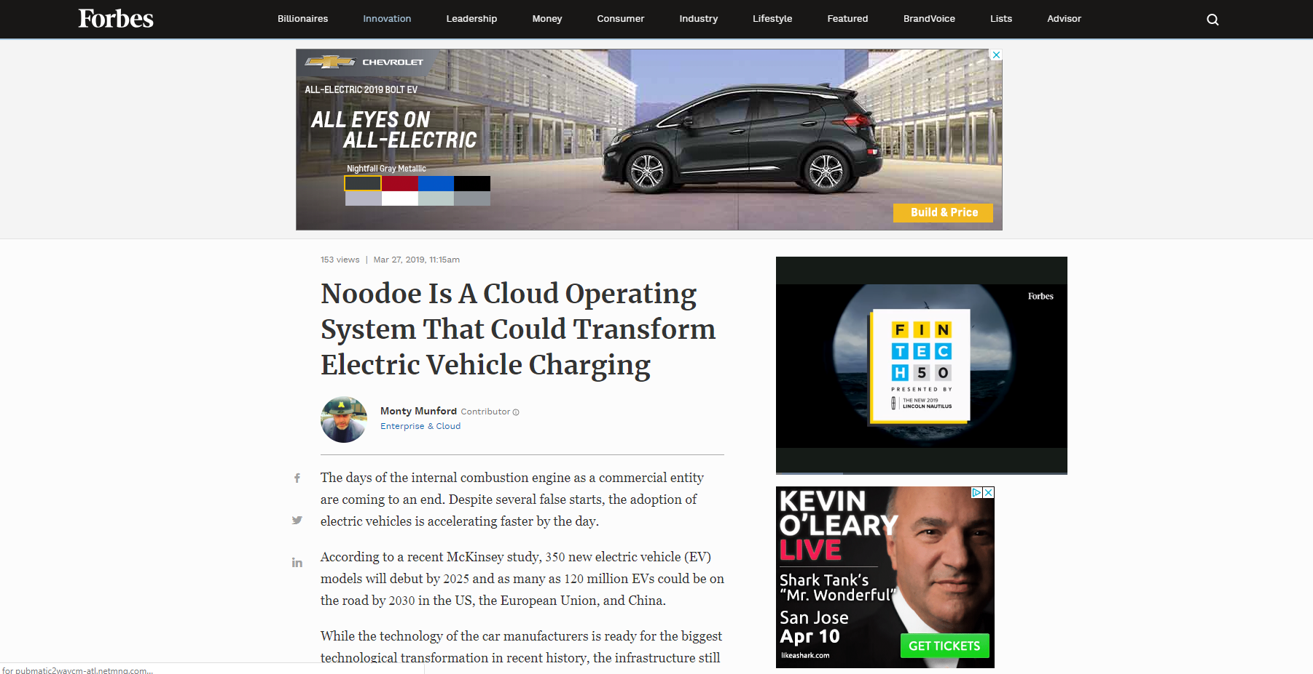

Slide 19
March 26th, 2019
Transform Cities with Smart
EV Charging Infrastructure

Slide 20
Noodoe EV Charger Grand Launch Party, Pomona LA 2018

Slide 21
Noodoe EV Automotive Solution

Slide 22
Noodoe Automotive Solution connects dealerships within
the dealership group to form a holistic EV charging network.

Slide 23
What makes Noodoe different: the entire dealership group
operates as a single network, instead of individual chargers.

Slide 24
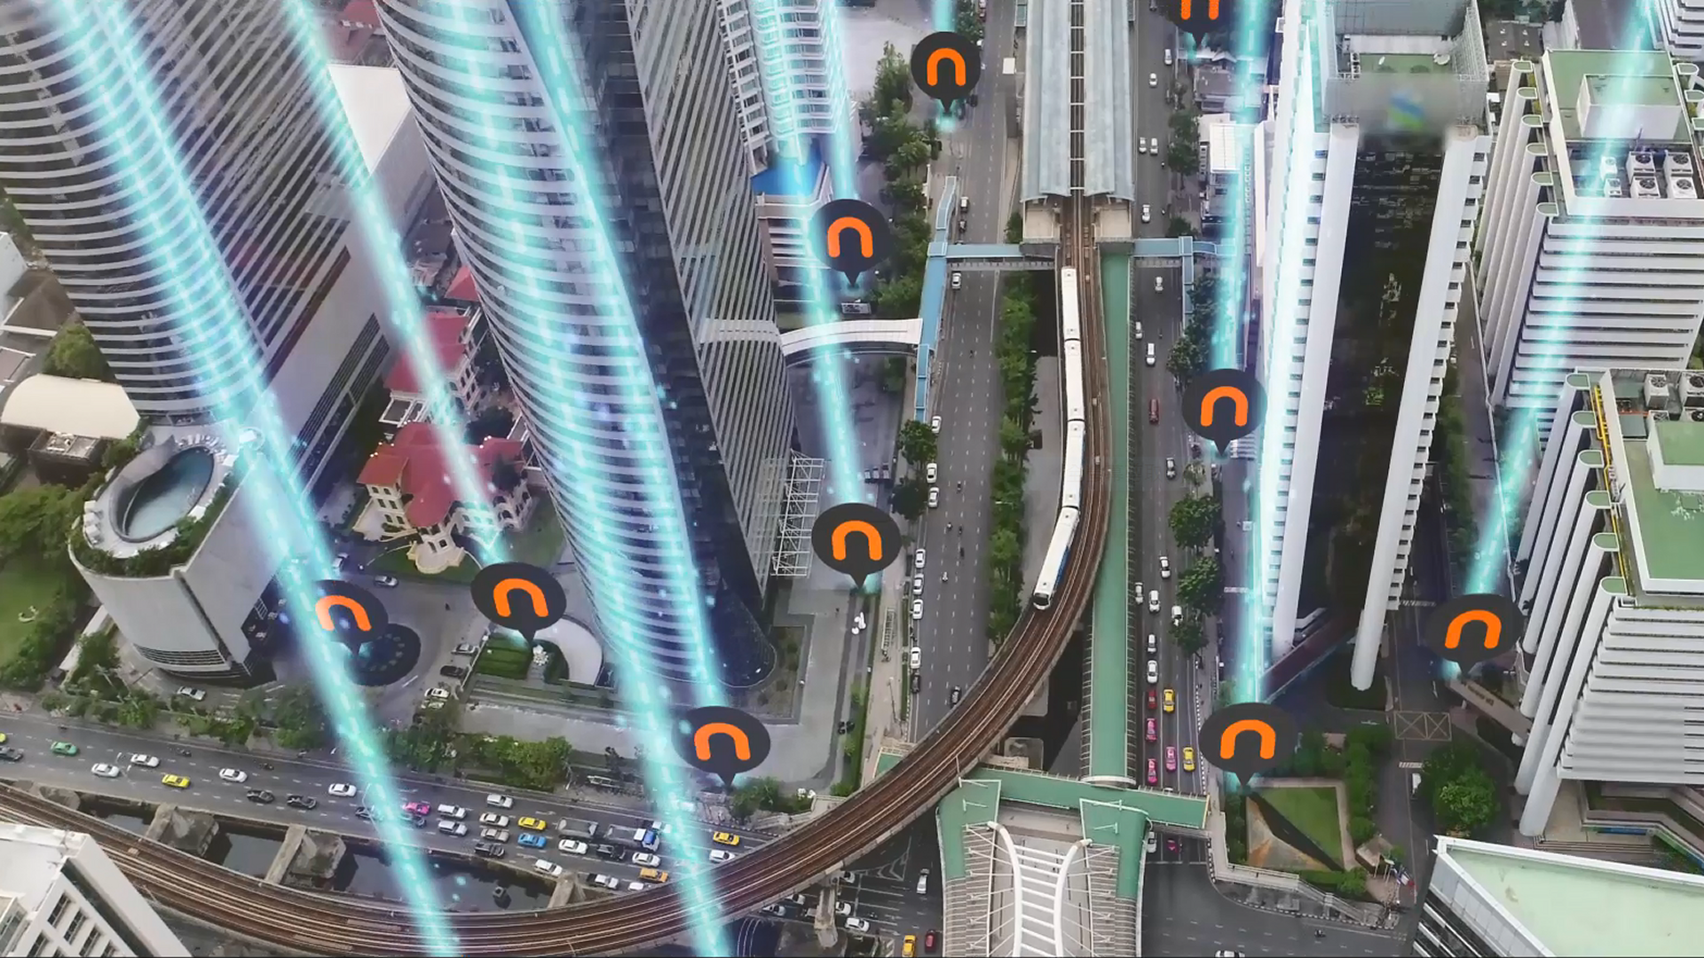
Noodoe EV OS is the central “brain” that runs the entire
EV charging network across multiple dealership locations.

Slide 25
Most importantly, Noodoe EV OS enables the dealership group to
give its loyal customers preferential VIP charging experiences.

Slide 26
Car owners are presented with a VIP badge.

Slide 27
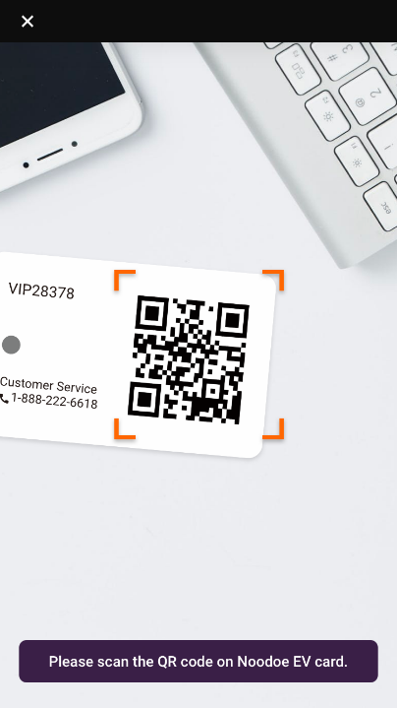
The VIP badge can be conveniently stored in the driver’s phone.

Slide 28
Using the phone, drivers simply scan the QR code to start charging.

Slide 29
Active VIP members enjoy FREE, unlimited charging within the network.

Slide 30
Other brands’ drivers still have to pay.

Slide 31
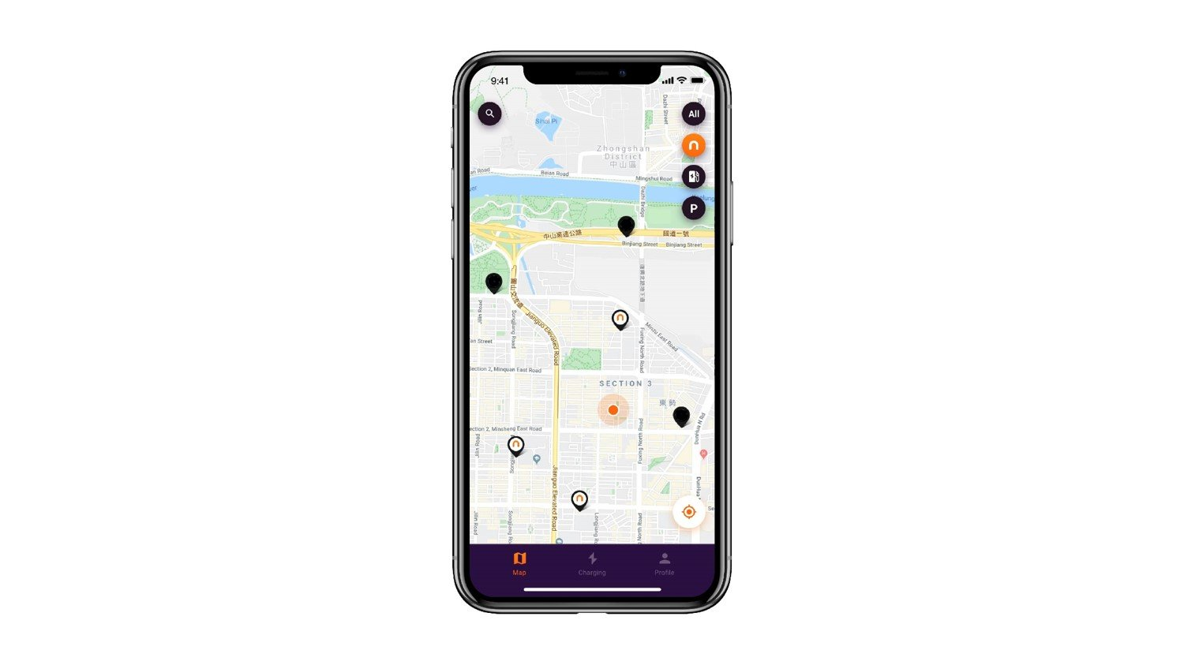
Real-time service availability is always at the driver’s fingertips.

Slide 32
Noodoe EV Automotive Solution
One holistic network across the dealership group
Preferential VIP charging for customers
Automated infrastructure diagnostics
Central control & management
Real-time operation analytics

Slide 33
Watch the video: Noodoe EV OS
https://youtu.be/mUNq4Umy64U

Slide 34
Watch the video: The Simplest Way to Charge Up Your EV
https://youtu.be/KT7d4XWfg7g

Slide 35
noodoe.com

